Slide 1
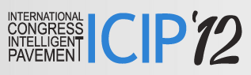

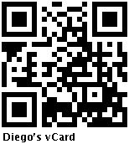

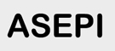
Towards Ambient Assisted Cities and Citizens Dr. Diego López-de-Ipiña González-de-Artaza DeustoTech-INTERNET, DeustoTech – Deusto Institute of Technology Madrid, 21 de Junio de 2012 dipina@deusto.es http://paginaspersonales.deusto.es/dipina http://www.morelab.deusto.es

Slide 2
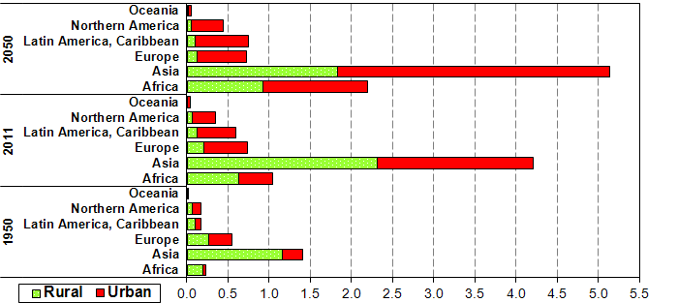
Society Urbanisation
Urban populations will grow by an estimated 2.3 billion over the next 40 years, and as much as 70% of the world’s population will live in cities by 2050
[World Urbanization Prospects, United Nations, 2011]

Slide 3
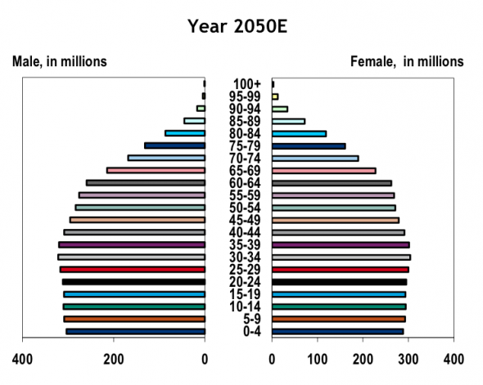
The Society is Aging
Dramatic shift in demographics
By 2050 the number of people over the age of 60 is expected to triple, and will outnumber children under 15 for the first time in human history [Business Insider, 2011]

Slide 4
What is a Smart City?
A means of making available all the services and applications enabled by ICT to citizens, companies and authorities that are part of a city’s system
It aims to increase ALL citizens’ quality of life and improve the efficiency and quality of the services provided by governing entities and businesses

Slide 5
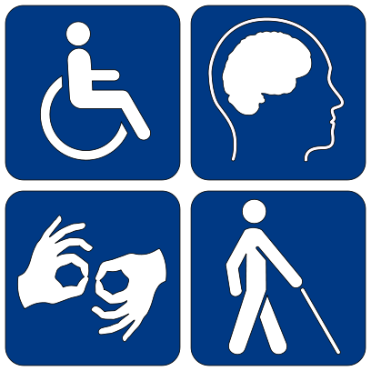
What is an Ambient Assisted City?
A city aware of the special needs of all its citizens, particularly those with disabilities or about to lose their autonomy:
Elderly people
The "Young Old" 65-74
The "Old" 74-84
The "Oldest-Old" 85+
People with disabilities
Physical
Sensory (visual, hearing)
Intellectual

Slide 6
Accessible & Inclusive Cities
According to the World Health Organization, people with disabilities make up about 15% (about 1 billion people) of the world’s population
Many cities have been investing on becoming more accessible, i.e. enabling the mobility and access to services to any person
Many public spaces have been transformed and instrumented:
Pedestrian ways’ barriers have been eliminated
Traffic lights use sound
Sensors have been spread throughout the cities
How do we truly progress towards fully inclusive cities?
We need to adapt not only the infrastructure but the services offered

Slide 7
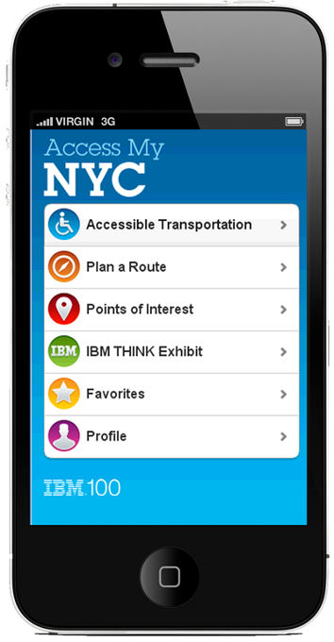
AccessMyNYC
AccessMyNYC is an app designed to help define requirements for more inclusive Smarter Cities
Brings together geo-location and mapping technologies, transportation data, and publicly available accessibility information to help N.Y.C. residents and visitors
Find information about accessible public and private transportation and plan a public transit or walking route
Identify accessibility information about points of interest citywide, including restaurants, hotels and most commonly visited attractions
Customize search criteria to filter accessibility information by personal needs and preferences
Rate and tweet about the accessibility of city systems and points of interest.

Slide 8
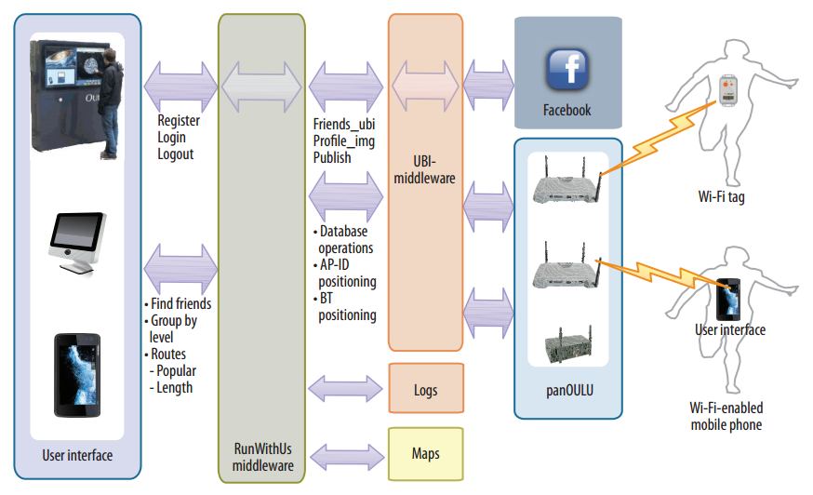
Run with Us
Smart cities should promote healthier lifestyles by using their urban wireless infrastructures to implement mechanisms that encourage residents to play sports and exercise
RunWithUs is a pilot deployed in Oulu to motivate city residents to exercise
Defines as social network of residents that can challenge each other
http://www.ubioulu.fi/en/UBI-summer-school-2011-workshops

Slide 9


Spanish inititatives: Mobility
Some Spanish initiatives have tackled how to overcome architectural barriers:
VIABLE project aims to offer real-time information about the status of the public ways in a place
LibreDeBarreras promotes citizen participation through mobile app:
http://libredebarreras.es/informacion

Slide 10
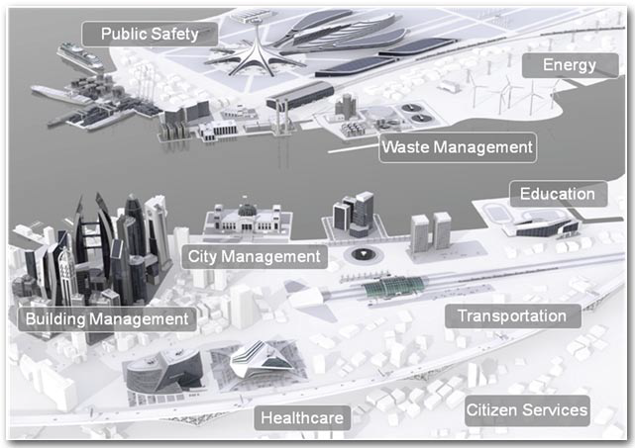
Global Smart City Initiatives
IBM the Smarter City
SIEMENS mobility solution
CISCO Smart+Connected Communities
Philips Livable City

Slide 11
Our work enhancing Accessibility in Public Spaces
BlindShopping: Enabling Accessible Shopping for Visually Impaired People through Mobile Technologies
How to translate this to the Smart Cities domain?
Imhotep: User-conscious adaptable mobile interfaces
How to apply it to Urban Apps?

Slide 12
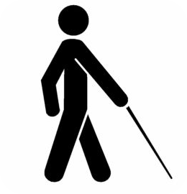
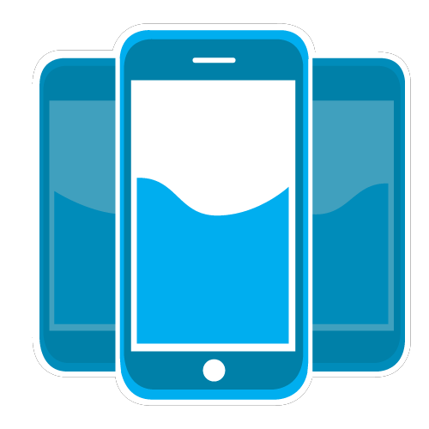
BlindShopping – Motivation
Blind people
70000 in Spain (ONCE,2009)
Difficulties in their daily life tasks
Smartphones
Increasing computing, communication and sensing capabilities
Sensorial complement for visually impaired

Slide 13
BlindShopping Platform
Goal: A platform that enables blind people to shop autonomously in a supermarket
What does it contribute with?
A navigation system
A product browsing mechanism
Directly applicable to the Smart City domain:
Enabling blind people to navigate and browse through the real-world’s objects and services

Slide 14
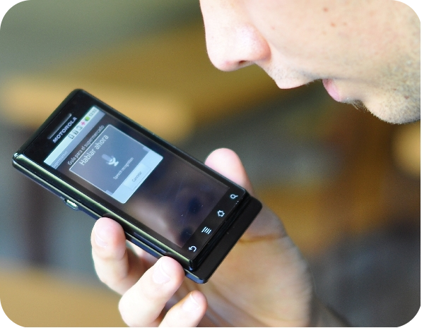

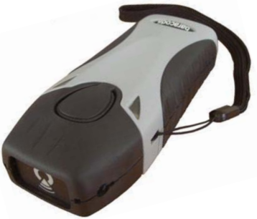
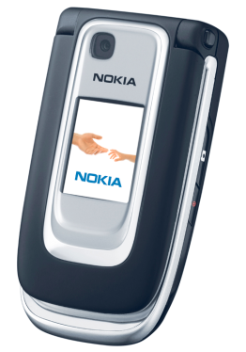
Navigation System
Guides the blind user inside the supermarket
Verbal interaction
Location defined by:
RFID tags distributed throughout the corridors
RFID reader attached to the white cane

Slide 15
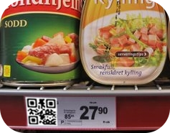
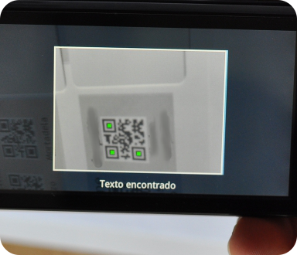
Product Recognition System
Tells the user information about products
Based on QR Codes
recognized by camera
one per product on the shelf
Verbal description

Slide 16

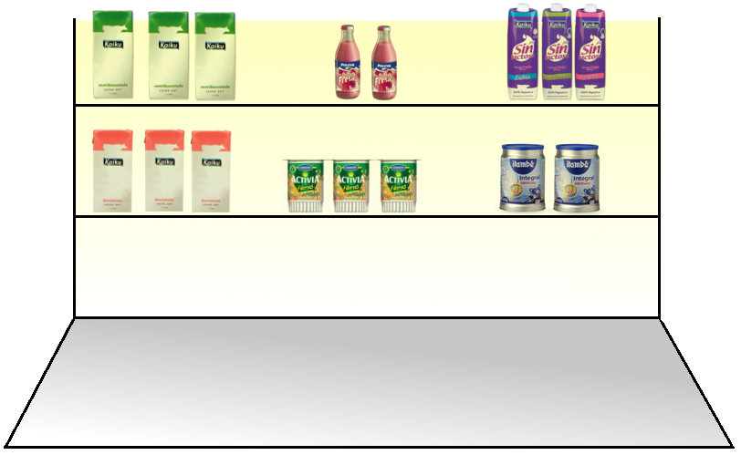

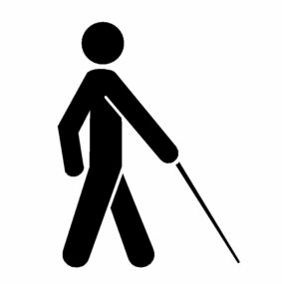
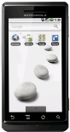
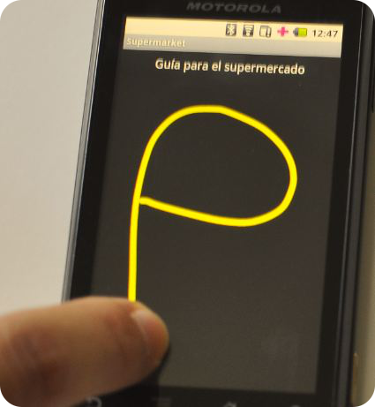
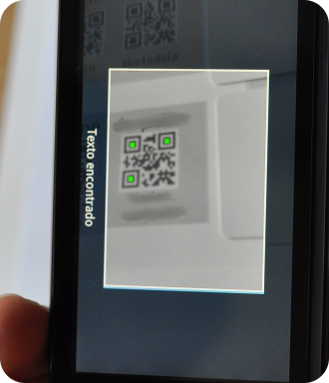

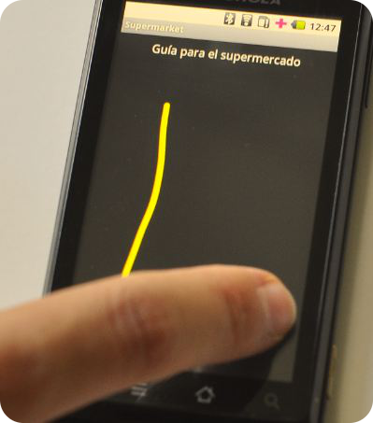

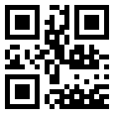

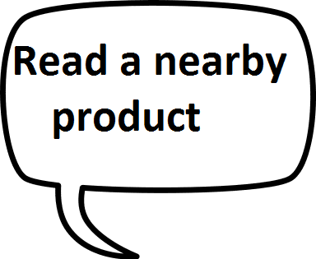

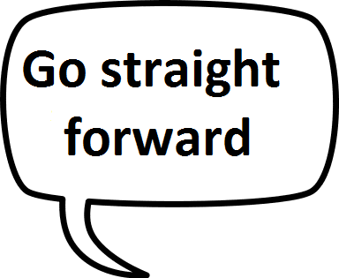

Slide 17








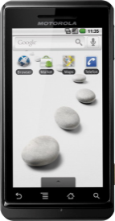



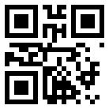













Platform Architecture
Speech Synthesis
Voice recognition
Web-Service query
QR Code reading
Web-Service response
Server
RFID info sending
RFID Tag reading
Management Front-end

Slide 18
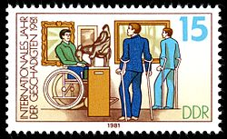
BlindShopping + iPavement = Accessible Tourism
What about if the pavement (tactile paving) of some core parts in a city could be enriched with RFID tags?
What about if the tips of white canes were instrumented with an RFID reader?
Accessible tourism would be enabled
It would ease navigation to POIs (Points of Interest)
Such POIs (statues, buildings, and so on) could be annotated with embossed QR codes or RFID tags readable through NFC.

Slide 19

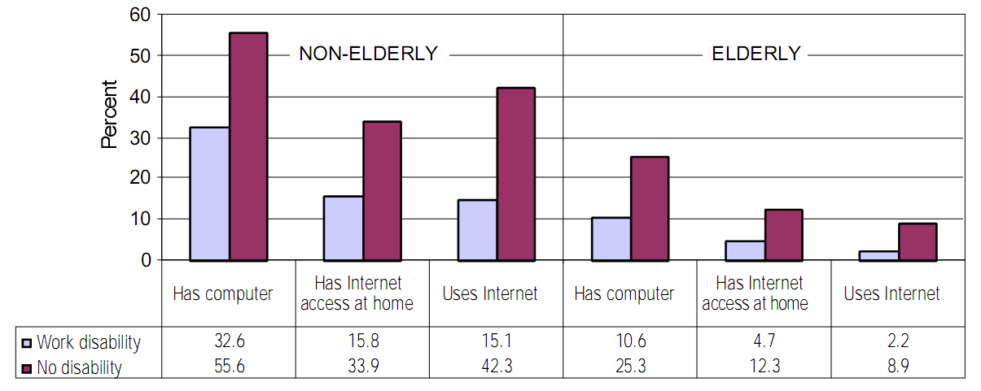
Imhotep: User-conscious adaptable mobile interfaces
Fewer technology users among elderly and people with disabilities
Kaye, H.S., Computer and Internet Use among People with Disabilities, in Disability Statistics Report 2000, Department of Education, National Institute of: Washington D.C.

Slide 20
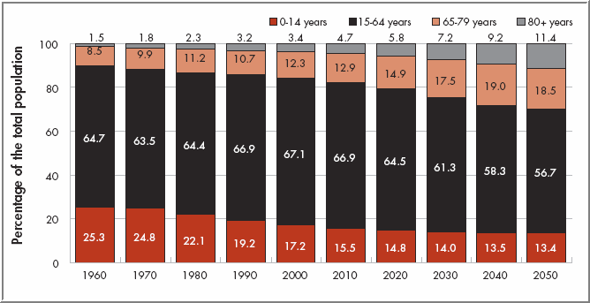
Need for adaptive interfaces
This user base is going to grow even more with the increasing of average age in Europe.
Population structure by major age group for EU-25 countries (1960 to 2050 estimates. European Commission (2007)

Slide 21
Need for adaptive interfaces
Developers traditionally tend to ignore or neglect this user base
The individual user groups (each disability have different requirements) may not be big enough to justify the additional development costs
Developing accessible applications can be difficult and error-prone

Slide 22
Imhotep
Aim → Provide tools that ease the development of adaptive, user-centric accessible applications
Design objectives:
Make the framework platform independent
Reduce the adoption costs
Help AAL programmers without expertise in accessible applications
Practical down-to-earth approach

Slide 23
Framework architecture
Composed by three main elements:
The pre-processor directives
The adaptation server
Aware of user and device capabilities
The fuzzy knowledge-eliciting reasoner (integrated in the adaptation server)

Slide 24
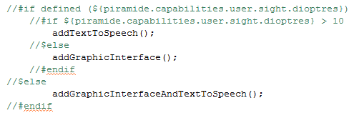
Preprocessor Directives
Conditional directives can be used to avoid the compilation of fragments of code if certain conditions are matched. These conditions can include calls to functions provided by the framework.

Slide 25
Fuzzy Knowledge-Eliciting Reasoner
Objectives
To infer new user and device capabilities from those specified in the profiles.
To enable the AAL developers to abstract from the crisp values (the user has less than 3 dioptres) in favour of more natural concepts (the user can see without a significant problem).

Slide 26
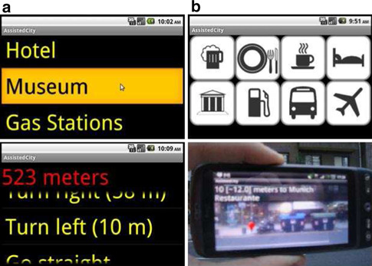
Assisted City
Imhotep-powered app to search nearby interesting locations (bars, restaurants, hotels, etc.), adapted to the user requirements and capabilities.
Adapted to blind users. Uses the Android TextToSpeech API to communicate and a graphic interface with different colors and font sizes to easy the reading.
Adapted to regular users. Users are driven to the selected point by using the augmented reality. As you can see in the image bellow, the distance to the point and a marker indicating its position is shown using the device camera.

Slide 27
Linked Cities and Citizens
“City appeal” will be key to attract and retain citizens, companies and tourists
User-driven and centric innovation:
The citizen should be heard, EMPOWERED!
Urban apps to enhance the experience and interactions of the citizen, by taking advantage of the city infrastructure
The information generated by cities and citizens must be linked and processed
How do we correlate, link and exploit such humongous data for all stakeholders’ benefit?
We should start talking about Big (Linked) Data

Slide 28
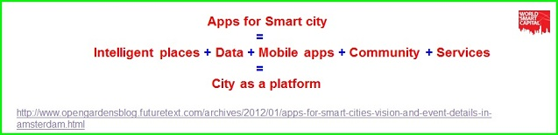
Towards Smart Assistive Linked Cities
Generation of user-centric solutions that exploit urban data in different domains and thus improve the use of existing urban infrastructure and resources
A sustainable and open ecosystem vs. “smart city in a box” solutions proposed by corporations such as IBM or Philips
Notes:
Ciudades que escuchan a sus ciudadanos
Transparencia en Bizkaia
Típicamente se requiere importantes inversiones para acometer un proyecto de smart ciy
Que no requiera rehacer la ciudad sino simplemente transformarlo, adaptarla, adecuarla

Slide 29
The LinkedCity project
“To create a multi-device dataset and application marketplace based on standard web technologies, that exploits the data shared by councils and their citizens, and provides to citizens, tourists and workers an enhanced experience in a municipality”
Notes:
Para ello definirá una plataforma asumiendo conectividad ubicua, uso de dispositivos en cualquier lugar y momento, las aplicaciones como servicios en la nube, uso de estándares abiertos, servicios basados en la localización y contexto del usuario, datos en tiempo real provistos por sensores, análisis avanzado de datos masivos en tiempo real, datos abiertos, datos sociales

Slide 30
LinkedCity Objectives
Transform and release municipalities’ open data into Open Linked Data
Generate structured council data from non-structured data coming from social networks and users
Integrate, normalize, link and publish data for its massive analysis and exploitation by councils, enterprises and citizens
Generate a scalable Cloud-based and NoSQL-based infrastructure that supports the urban apps marketplace
Create a set of urban apps over the normalized data of a council, its citizens and companies
Disseminate and transfer the service and data marketplace platform to companies and administrations

Slide 31
Architecture
Notes:
¿QUÉ?
Plataforma software abierta que de modo flexible y escalable provea un marketplace de servicios y datos urbanos
¿CÓMO?
Procesando y dando sentido a los datos aportados por infraestructuras sensoriales, datos abiertos del municipio y la información en redes sociales sobre el mismo, incluso la informacion contribuida por los propios ciudadanos o por empresas con un fin comercial
¿POR QUÉ?
Mejorar la administración municipal, ofrecer oportunidades de negocio a las empresas proveedoras de servicios y nuevos datos agregados, ofrecer servicios urbanos a los ciudadanos, visitantes, y empresas
¿DÓNDE?
Usará 2 municipios de Bizkaia como un Living Lab donde evaluar y demostrar las oportunidades de negocio de este enfoque

Slide 32

I have a dream … the user-enpowered inclusive City
iPavement is an enabling technology for Inclusive Cities
iPavement may collect data, e.g. people transiting through a given area
Open data from a given council should be linked to real-time data gathered by iPavement and other city sensors or prosumers
Relevant location-aware apps can be recommended to surrounding citizens and visitors according to their profile and capabilities
User-conscious apps should adapt to the capabilities of different users, their devices and current context

Slide 33
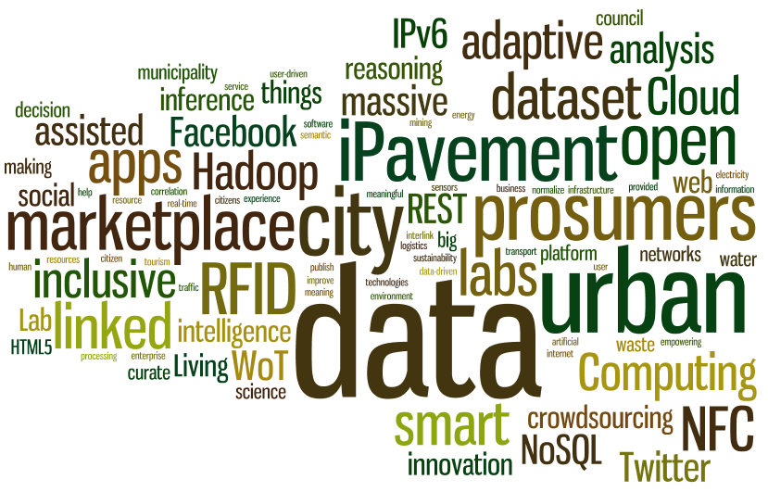
I have a dream … the user-enpowered inclusive City

Slide 34
Towards Ambient Assisted Cities and Citizens http://www.slideshare.net/dipina/ Dr. Diego López-de-Ipiña González-de-Artaza DeustoTech-INTERNET, DeustoTech – Deusto Institute of Technology Madrid, 21 de Junio de 2012 dipina@deusto.es http://paginaspersonales.deusto.es/dipina http://www.morelab.deusto.es

